Slide 1
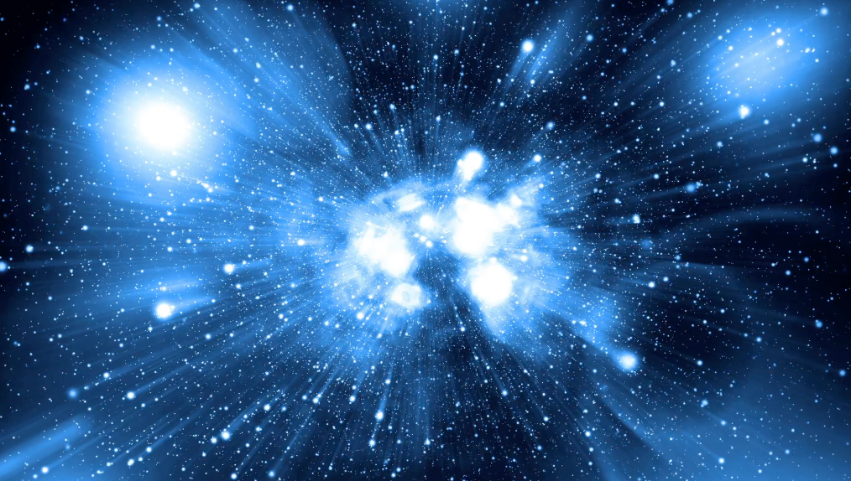


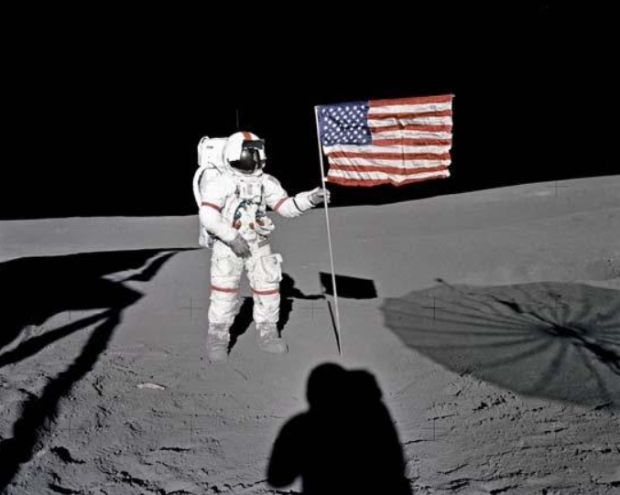


United States Space Force
Home
Careers
Contact a Recruiter
News
Our Mission
When the going gets tough, we get tougher. The United States Space force is the most recent branch installment in the U.S. Our mission is to guard the Earth from space debris, detect incoming Asteroids, black holes, etc. We outgo constant broadcasts and attempt to discover alien life. Not every encounter is expected to go out smoothly, so if we do find hostiles not willing to cooperate or impose a threat, we have enough nukes that will send E.T. running home!
Privacy Policy
FAQ
Join the fight!
www.spaceforce.com
Connect

Slide 2
United States Space Force
Home
Careers
Contact a Recruiter
News
Careers
There are many careers to choose from. Whether you want to be right in the fight, guarding the Earth from asteroids, or going on diplomatic missions. There is something out there for you!
Officer | Warrant | Enlisted
Ship Captain | Hyper Drive Specialist | Engineering
Crew Chief | Hostile Threat Advisor | Medic
Robot Systems Chief | Robot Mechanic | Plumbing
Space Marine Captain | Space Marine | Infantry
Diplomatic Ambassador | Diplomatic Advisor | Computer Science
First Contact Chief | First Contact Advisor | Computer Technician
(Much more) | (Much more) | (Much More)
Privacy Policy
FAQ
Join the fight!
www.spaceforce.com
Connect

Slide 3


United States Space Force
Home
Careers
Contact a Recruiter
News
Contact a Recruiter
We are actively searching for new recruits! Think you have what it takes? Try contacting us and a recruiter will contact you shortly!
(First Name)
(Last Name)
_________
_________
(Address)
(City)
(State)
(Zip)
_________
_____
_____
____
(Email)
(Phone)
_____
_____
Privacy Policy
FAQ
Join the fight!
www.spaceforce.com
Connect

Slide 4
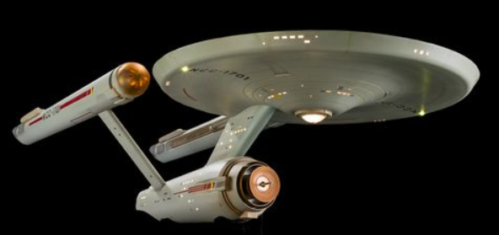
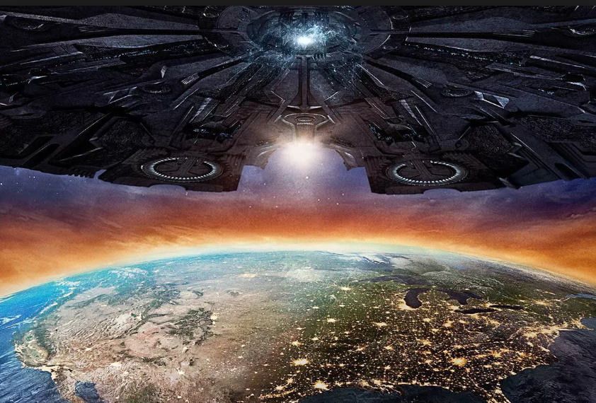
United States Space Force
Home
Careers
Contact a Recruiter
News
News
Searching for new life
The voyage to seek out new life and new civilizations, and to boldly go where not man has gone before is under way. No new developments so far, but more advancements are coming by the minute!
Earth Destruction Attempt
Hostile alien threat attempt to take over earth. Computer Scientist under the name David Levinson quickly reacts, hacking their defenses allowing us to blow them to smithereens! Job well done!
More to Come!
Stay tuned for updates and more exciting news!
Privacy Policy
FAQ
Join the fight!
www.spaceforce.com
Connect

